Slide 1
Navajo Nation Water Quality
Jaden Redhair

Slide 2
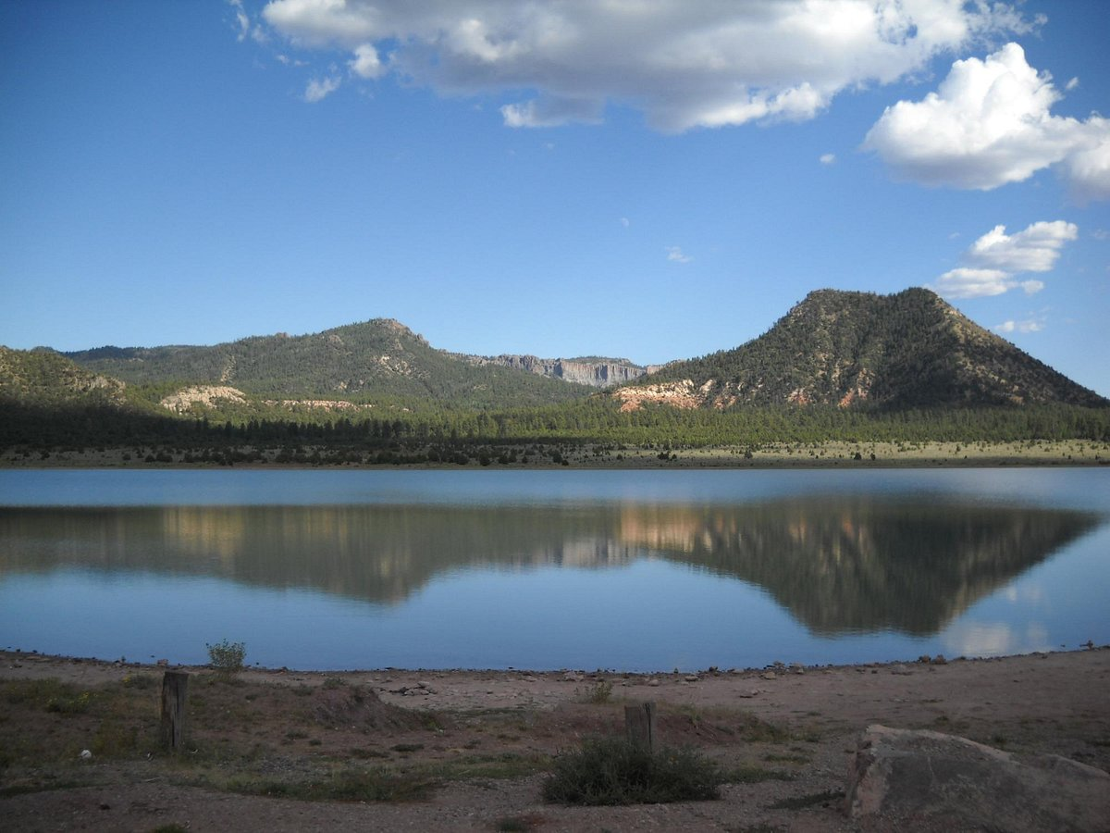

Slide 3
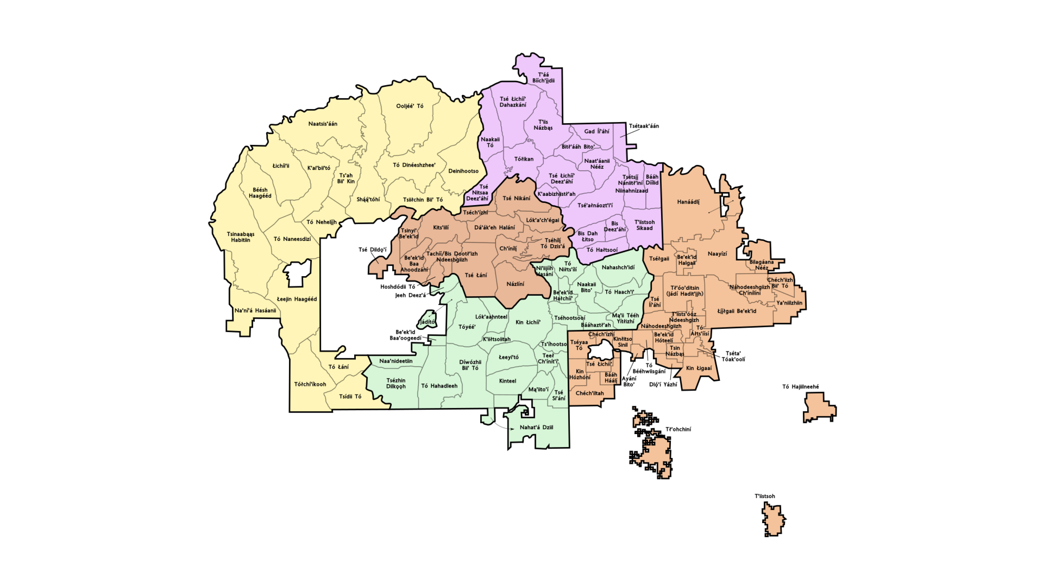

Slide 4
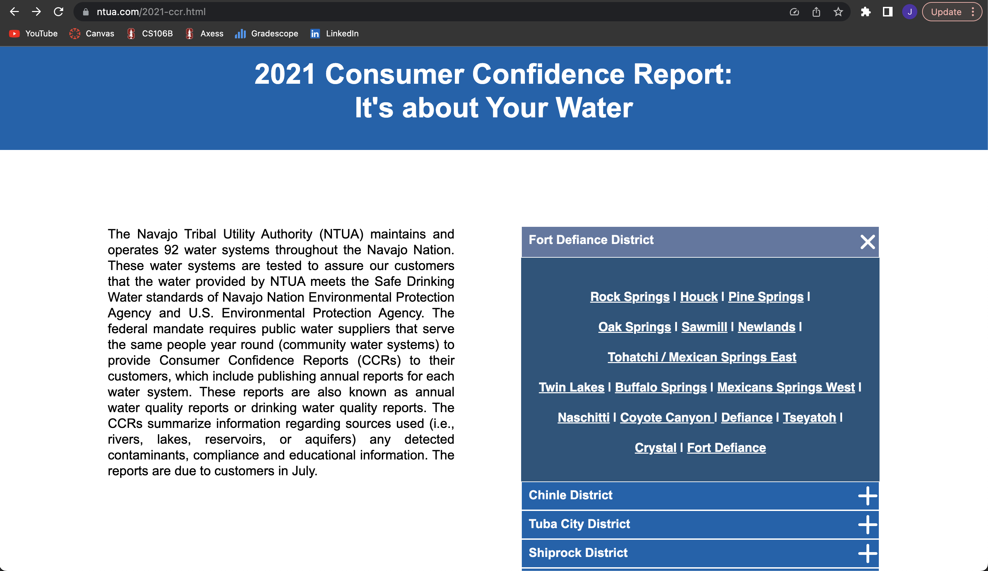

Slide 5
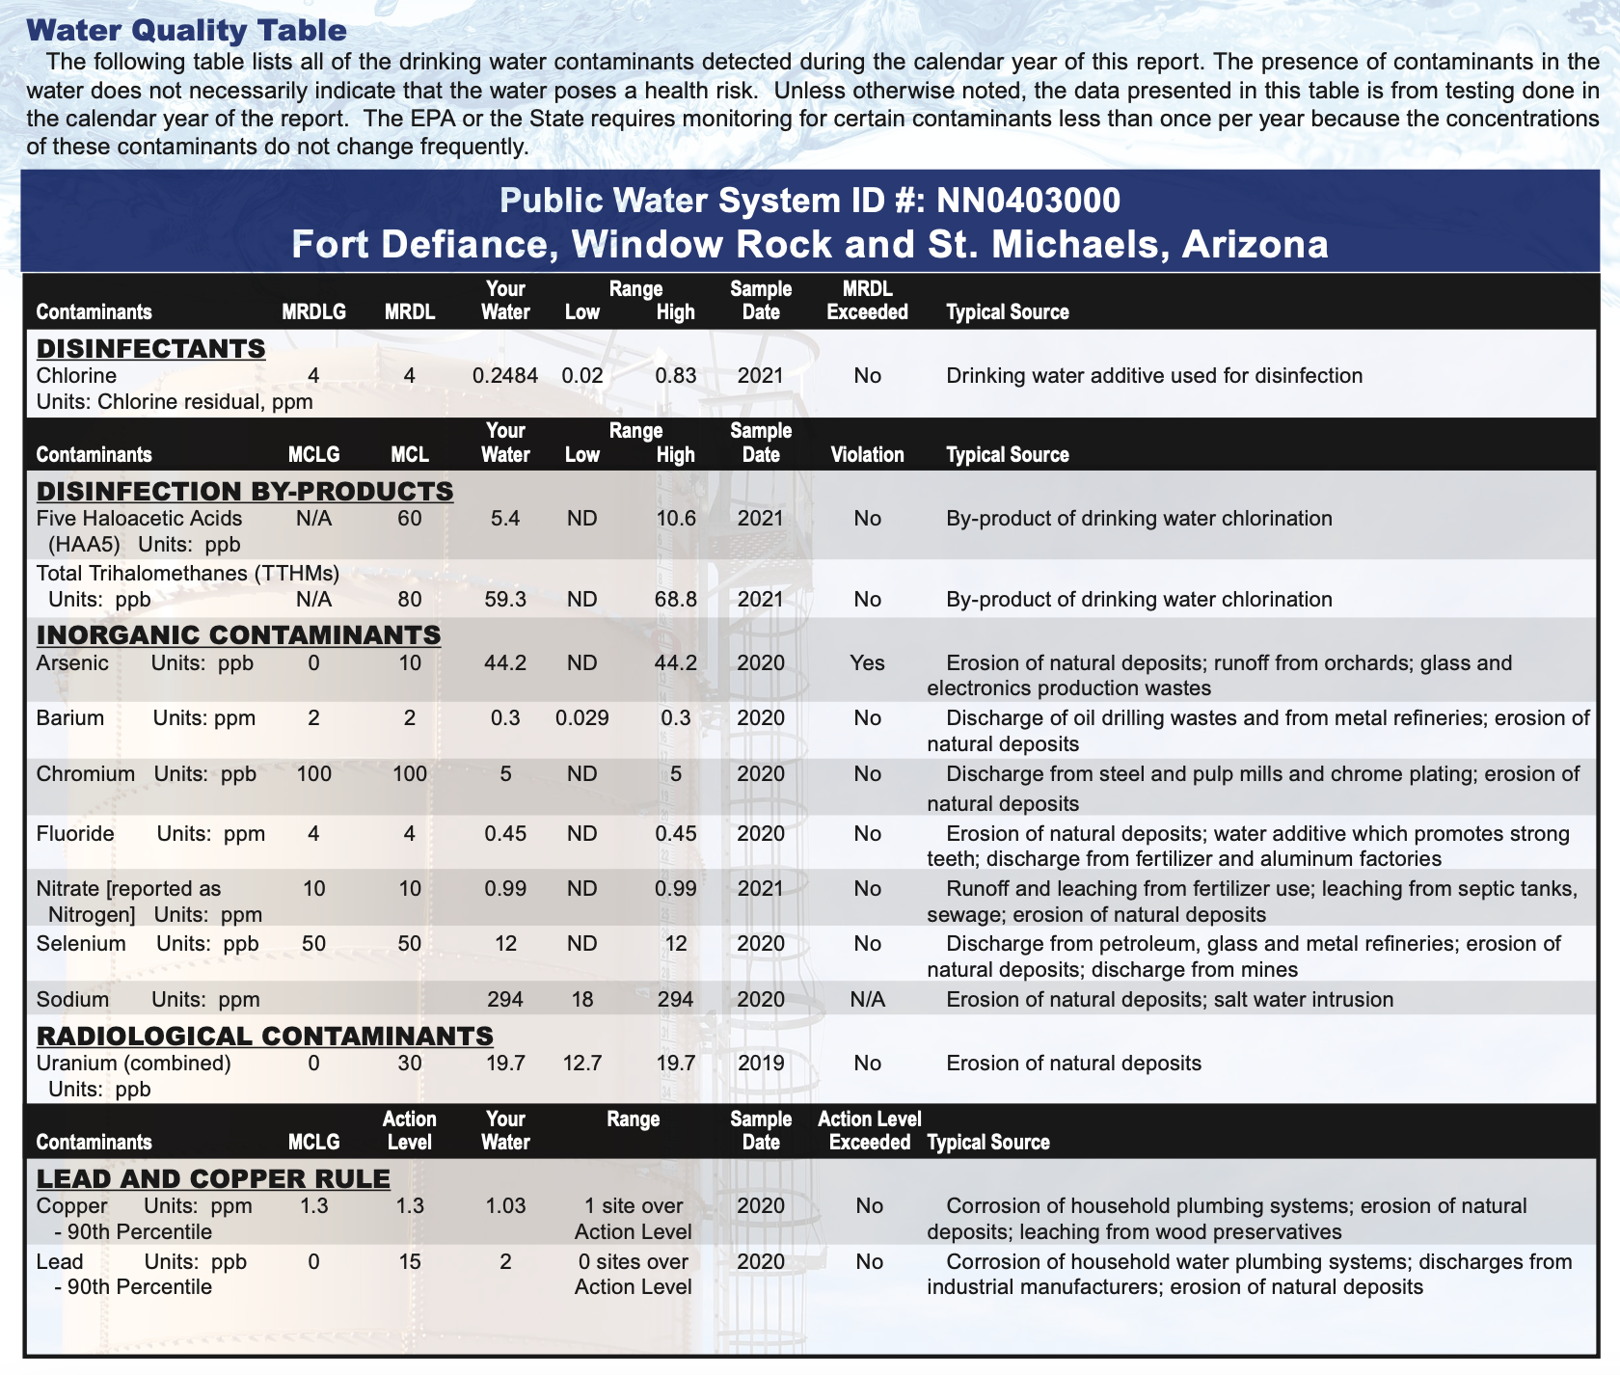
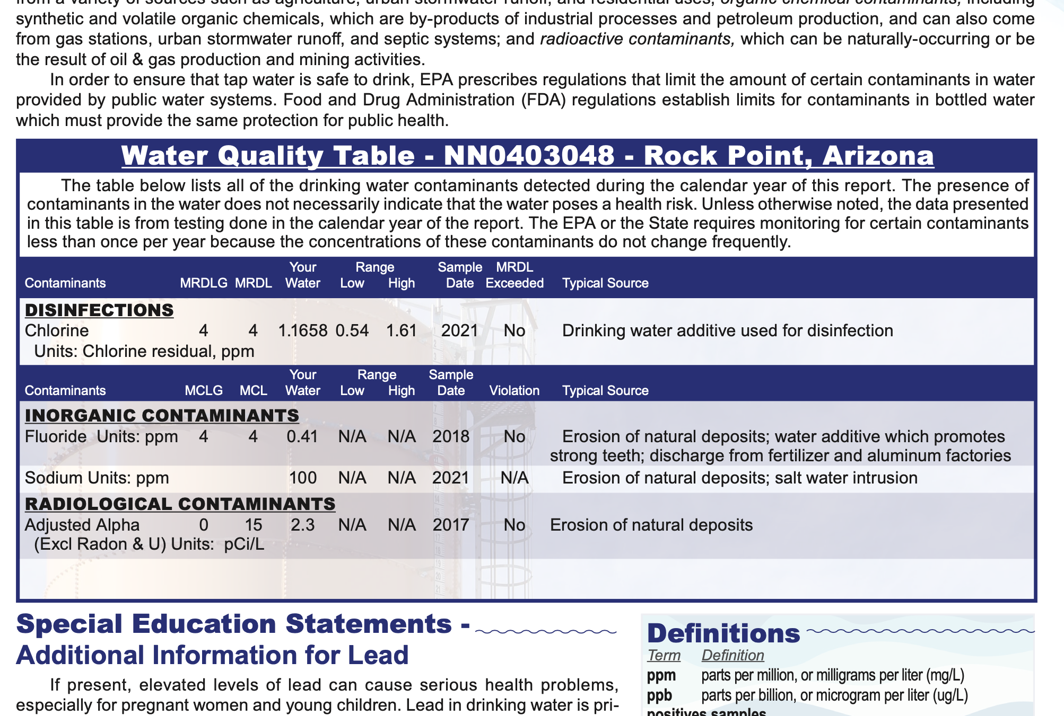
Data Collection

Slide 6
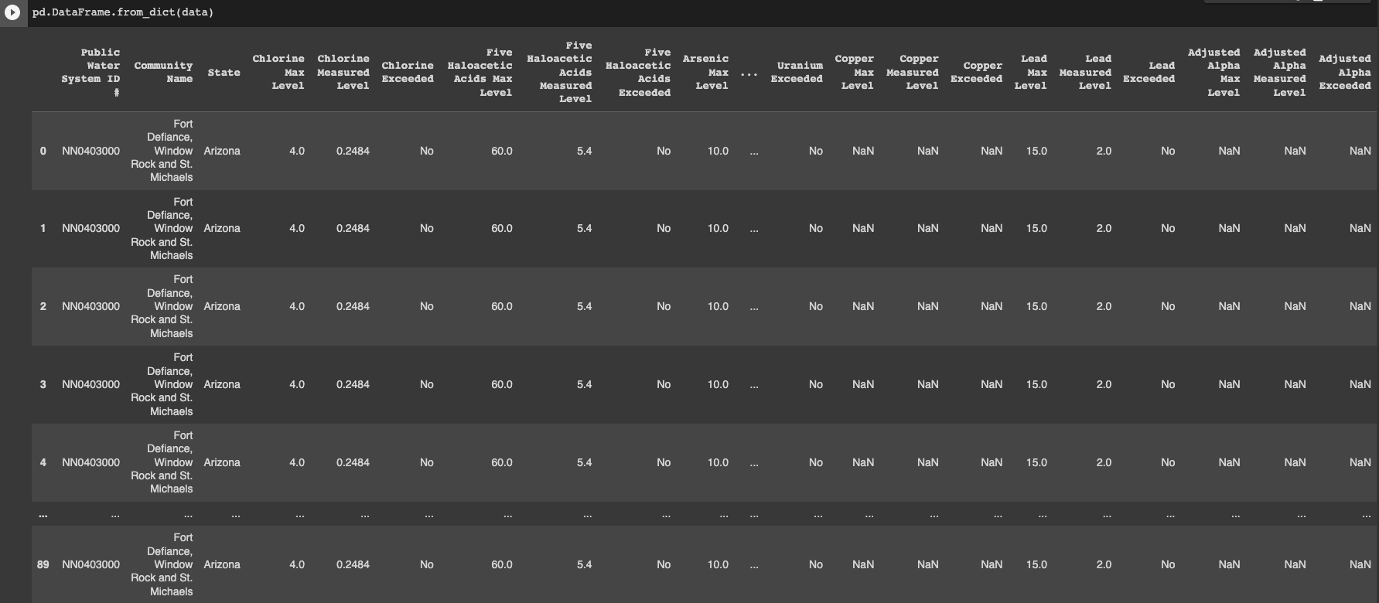
In Colab

Slide 7
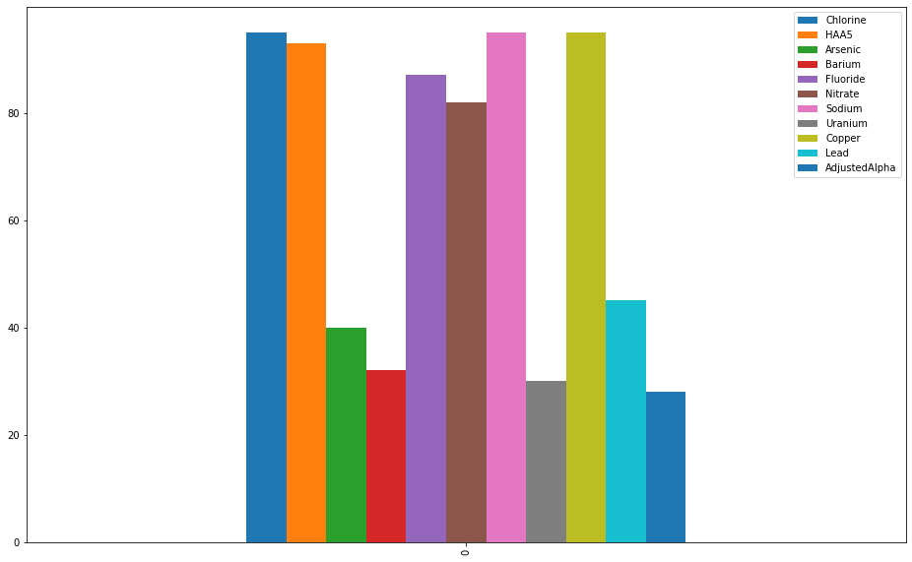

Slide 8
Arsenic? Why is that in water?
Erosion of natural deposits
Runoff from orchards
glass and electronics production wastes
What does it do to people?
Drinking water containing arsenic in excess of the allowable limit over many years may experience:
Skin damage or circulatory system problems and may have an increased risk of getting cancer.

Slide 9
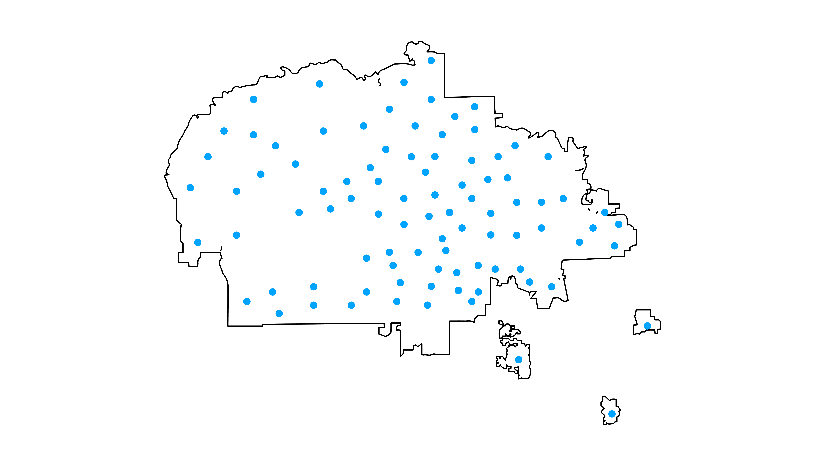

Slide 10
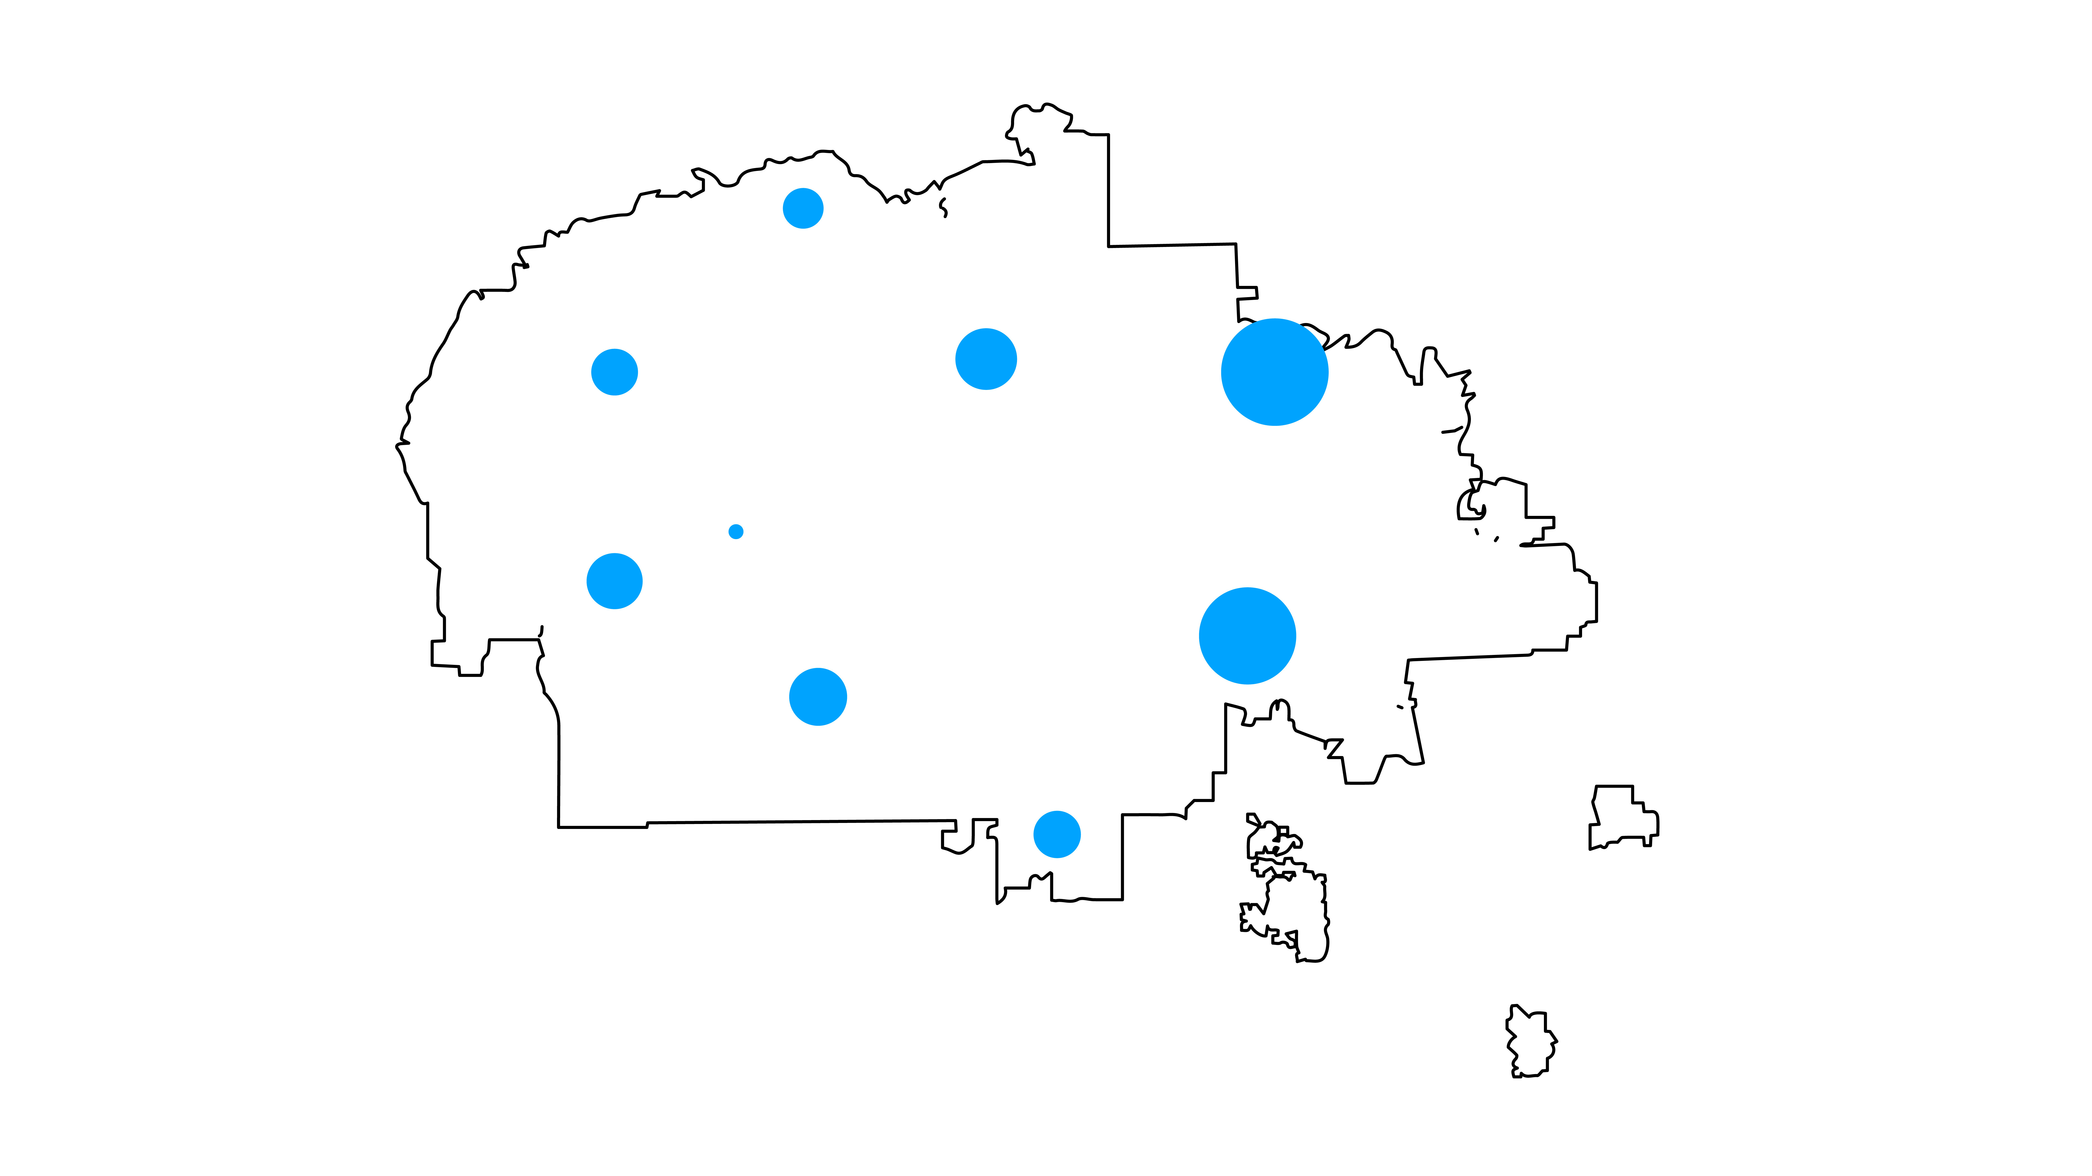
Clustering the communities

Slide 11
Clustering the communities

Slide 12
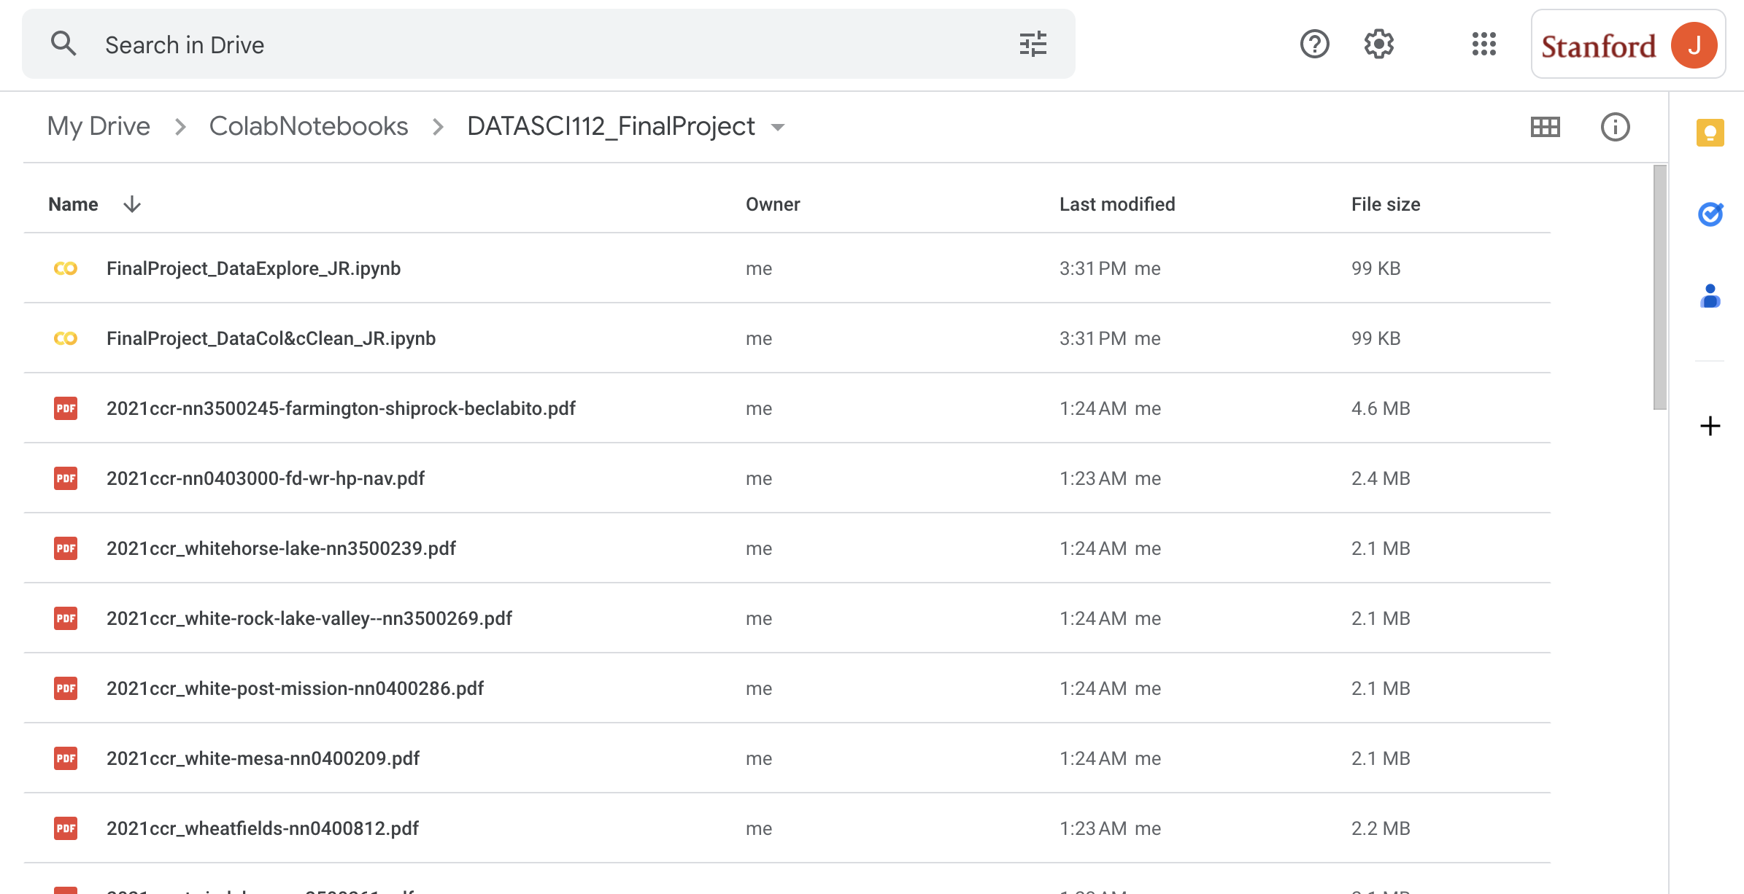
Oh no! Where is my ML stuff?

Slide 13
ML Summary
Used K-Regressor and Linear Regressor
Predict with a ~23 (ppb) RMSE with ensemble
Meaning I predicted Arsenic in the water supply not reliably. It had enough error to make arsenic levels over the allowable limit easily.
Need to add more features to get a better prediction. Maybe information on dumped trash?

Slide 14
What’s next with the model? Water quality check app?

Slide 15
Thank you
Questions?

